Slide 1








Integrated Crop Yield Recommendation and Prediction System Using R: Enhancing Agricultural Output Through Interactive Insights
SDG 2: Zero Hunger
Goal: End hunger, achieve food security and improved nutrition, and promote sustainable agriculture.
Relevance: Our project aims to optimize crop yields and make better crop recommendations, directly contributing to food security and sustainable agricultural practices.
By
LEKHANA S – 21MIA1080
RESHMA D – 21MIA1081
NARTHANA S – 21MIA1124

Slide 2
Abstract
This project presents the "Integrated Crop Yield Recommendation and Prediction System Using R," designed to enhance agricultural output through data-driven insights. Utilizing a comprehensive dataset, the system employs advanced machine learning techniques, particularly Random Forest algorithms, to recommend suitable crops based on environmental factors such as temperature, humidity, soil moisture, and nutrient levels. The application integrates crop yield prediction, allowing users to input specific parameters to forecast yield outcomes effectively. Additionally, it offers functionalities for seasonal yield forecasting, production efficiency analysis, and fertilizer and pesticide recommendations tailored to specific crops and seeds. By leveraging interactive insights and visualization tools within an R environment, this system aims to empower farmers and agricultural stakeholders to make informed decisions, ultimately leading to optimized agricultural practices and improved productivity.

Slide 3
Objectives
Crop Recommendation: Develop a system to recommend suitable crops based on environmental factors.
Yield Prediction: Build models to estimate crop yields from various inputs.
Seasonal Forecasting: Analyze data to determine optimal crops for specific seasons.
Production Efficiency: Evaluate and optimize the efficiency of different crops.
Missing Data Handling: Implement strategies to address missing production values.
Fertilizer and Pesticide Suggestions: Provide tailored recommendations to enhance productivity.
Crop Information Retrieval: Offer detailed insights on crop characteristics and practices.
Interactive User Interface: Create an interactive application in R that allows users to input specific parameters and receive recommendations and predictions.
Visualization of Insights: Utilize visualization tools to present data insights and model outcomes, enhancing user understanding and decision-making.

Slide 4
Methodology
Project Setup
Libraries & Data Loading: Load R libraries (dplyr, caret, randomForest, ggplot2, shiny, stringr) and datasets: Crop Recommendation, Crop Prediction, and Balram Data for fertilizers and pesticides.
Data Preprocessing
Label Encoding: Convert label column to factor for classification.
Data Cleaning: Trim spaces and handle missing values by replacing NA with zero.
Model Training
Random Forest Model for Recommendations: Predict optimal crops based on soil and environmental features.
Crop Yield Prediction Model: Split dataset (80/20) and train to predict yields using environmental inputs.
Visualization
Yield Distribution: Create histograms and boxplots for crop yields.
Correlation Heatmap: Visualize relationships between environmental factors and yields.
Feature Importance Plot: Display importance of features in yield prediction.

Slide 5
Function Definitions
recommend_crops: Predicts top three crops based on input parameters.
predict_yield: Returns predicted yield and performance metrics.
predict_best_crop: Filters data for the best crop by season and region.
calculate_efficiency: Computes and visualizes average production efficiency.
impute_missing_production: Fills missing values with mean production.
recommend_fertilizer_pesticide: Provides recommendations based on crop type.
crop_details: Retrieves specific crop information.
Chatbot Interface
User Interaction: Interactive command-line interface for crop recommendations and predictions.
Error Handling
Manage invalid inputs with user feedback for non-numeric values or incorrect options.
Model Evaluation
Assess model performance using R-squared and RMSE.
User Experience
Format outputs for clarity, ensuring readability of recommendations.

Slide 6
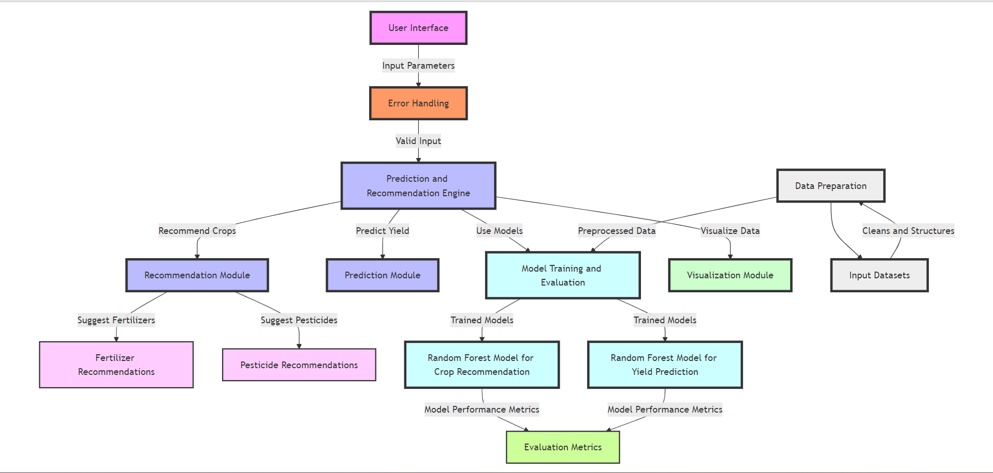
Architecture Diagram

Slide 7
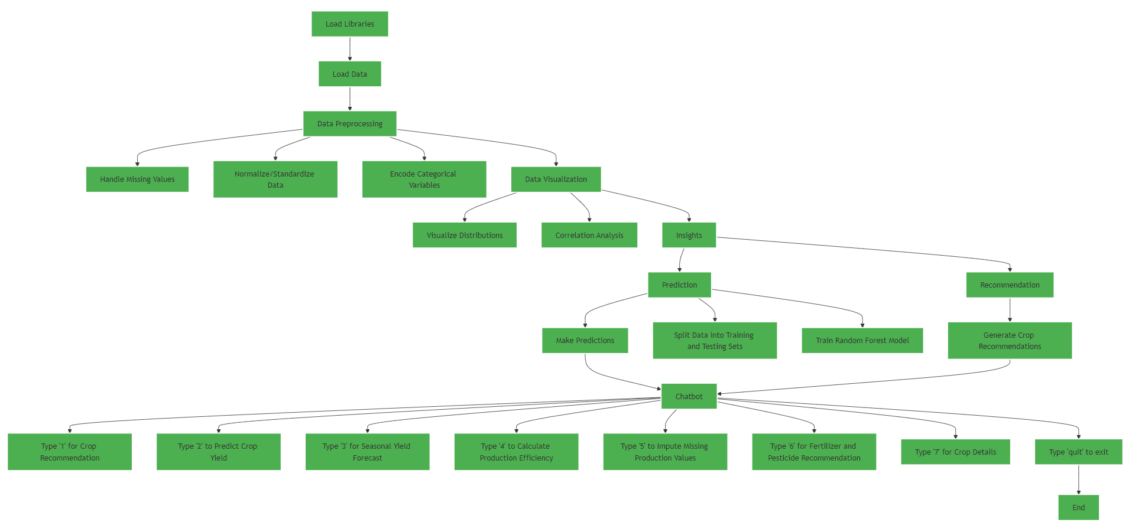

Slide 8
Module Descriptions
A. Crop Recommendation Module
Purpose: This module recommends up to three suitable crops based on environmental conditions.
Functionality:
Utilizes a Random Forest model trained on crop recommendation data.
Takes inputs such as temperature, humidity, rainfall, soil pH, and nutrient levels (Nitrogen, Phosphorus, Potassium).
Predicts probabilities for each crop and sorts them to provide the top recommendations.
B. Crop Yield Prediction Module
Purpose: To predict the yield of a specific crop given various parameters.
Functionality:
Trains a Random Forest model on crop yield data.
Inputs required include temperature, humidity, soil moisture, area, and crop type.
Returns the predicted yield along with model performance metrics (R² and RMSE).
C. Seasonal Yield Forecasting Module
Purpose: To forecast the best crop for a given season and region.
Functionality:
Filters historical production data based on the specified season and district.
Computes average production to identify the crop with the highest yield for the given conditions.
D. Production Efficiency Calculation Module
Purpose: To calculate the production efficiency of crops.
Functionality:
Aggregates data to compute the average production per area for each crop.
Returns a summary of production efficiency by crop.

Slide 9
Module Descriptions
F. Fertilizer & Pesticide Recommendation Module
Purpose: To recommend suitable fertilizers and pesticides for a specific crop and seed.
Functionality:
Filters a dataset based on the crop and seed name to provide corresponding fertilizer and pesticide recommendations.
Returns the unique recommendations formatted for clarity.
E. Impute Missing Values Module
Purpose: To handle missing production values in the dataset.
Functionality:
Replaces NA values in the production column with the mean production value of the dataset.
G. Crop Details Module
Purpose: To provide detailed information about specific crops and their seeds.
Functionality:
Retrieves data such as seed rate, average yield, location, and special features based on crop and seed names.
Formats and organizes the output to eliminate duplicates and provide a clear summary.

Slide 10
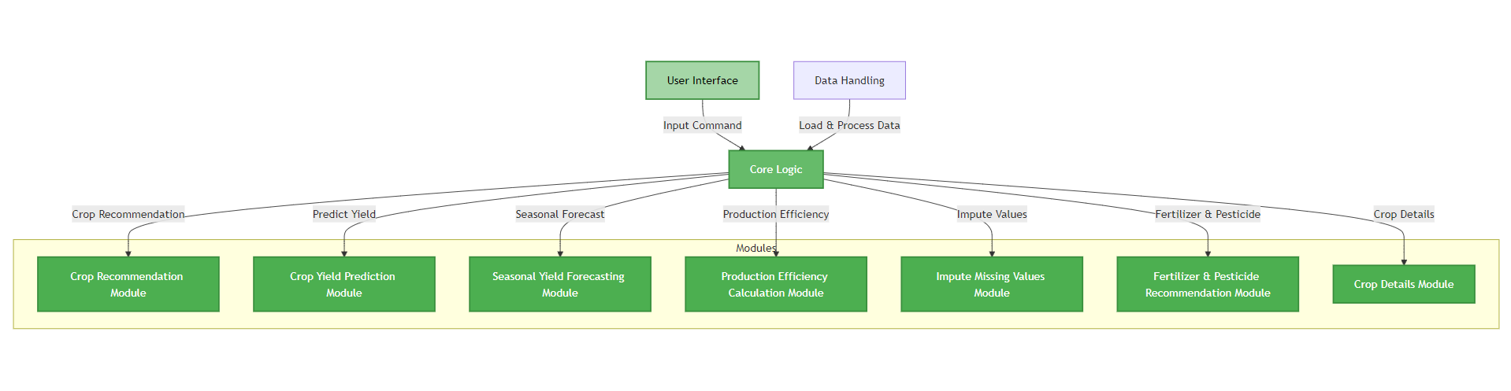
Module Flow Diagram

Slide 11
Datasets Description
DATASET LINK:
https://drive.google.com/drive/folders/1C0YoNe8c7-Kj8tKBbkpQvnytIOXPeGaB?usp=sharing
Balaram Dataset:
Number of features (Columns): 14
Number of rows: 75
Column names:
crop_name
seed_name
rainfall
soil
irrigation
sowing_time
maturity_time
seed_rate
avg_yeild
fertilizer
pesticide
location
special_feature
Unnamed: 13 (an extra column, possibly empty or irrelevant)
Crop Recommendation Dataset:
https://www.kaggle.com/datasets/atharvaingle/crop-recommendation-dataset
Number of features (Columns): 8
Number of rows: 2,200
Column names:
N (Nitrogen)
P (Phosphorus)
K (Potassium)
temperature
humidity
ph
rainfall
label (Recommended crop)
Crop Prediction Dataset:
Number of features (Columns): 10
Number of rows: 49,999
Column names:
State_Name
District_Name
Crop_Year
Season
Crop
Temperature
Humidity
Soil_Moisture
Area
Production

Slide 12
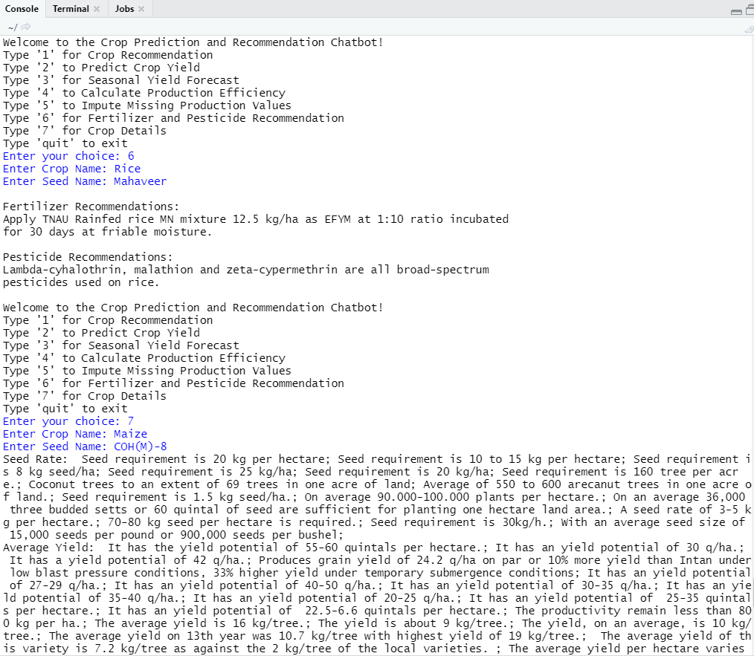
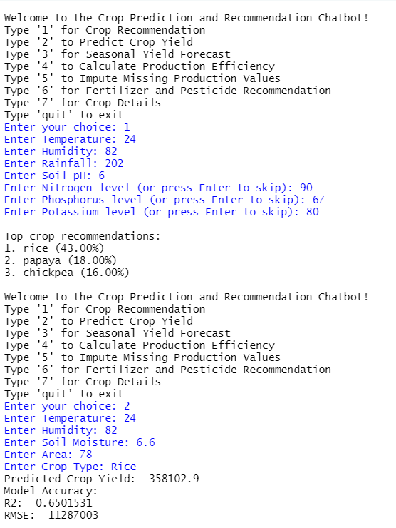
Output Screenshot

Slide 13
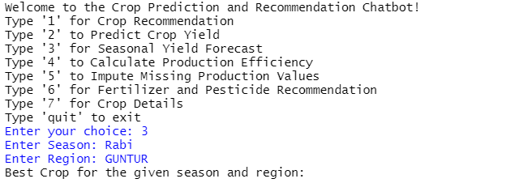
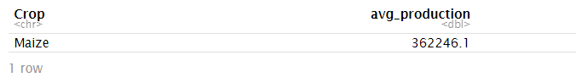
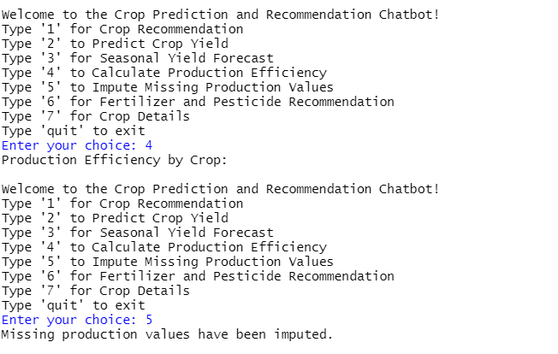
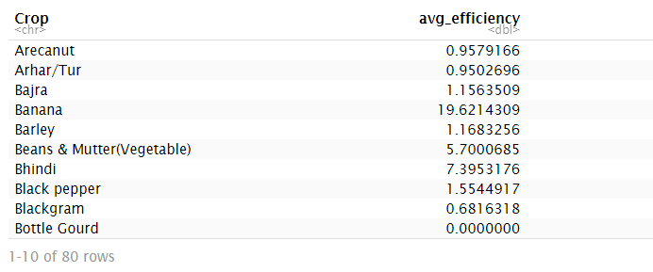

Slide 14
Inferences
Crop Recommendation: The Random Forest model provides effective crop recommendations based on environmental factors, aiding farmers in choosing the best crops for optimal yield.
Yield Prediction: The model accurately forecasts crop yield using factors like temperature and soil moisture, helping in resource planning.
Seasonal Forecasting: It identifies the most productive crops for specific seasons, guiding farmers to maximize yield and minimize risk.
Production Efficiency: The function identifies high-efficiency crops, optimizing land use and boosting productivity.
Data Imputation: Missing production data is accurately filled, ensuring a complete dataset for reliable analysis.
Fertilizer & Pesticide Advice: The function provides tailored recommendations, enhancing crop growth and reducing costs.
Crop Details: Detailed crop information supports informed decision-making for effective agricultural management.

Slide 15
References
Qazi, H., Rahman, Z., Jamil, M., Rafiq, M. N., & Ali, S. (2021). "Predictive analysis of crop yield using machine learning techniques." Agricultural and Biological Research, 37(3), 412-423.
Singh, A., Sharma, S., & Kaur, N. (2021). "A review on crop yield prediction models and algorithms." International Journal of Computer Applications, 183(5), 14-20.
Kumar, R., Kumar, R., & Aggarwal, R. K. (2021). "Machine learning-based crop yield prediction in India using climatic parameters." Journal of Agricultural and Food Information, 22(4), 343-360.
Patel, H. R., Patel, V., & Sharma, R. (2021). "Analyzing the impact of climatic factors on crop yield using regression models." Indian Journal of Agricultural Sciences, 91(2), 203-208.
Babu, S., & Reddy, V. S. (2021). "Forecasting crop production using ARIMA and machine learning models." Journal of Agricultural Science and Technology, 23(2), 107-120.
Ahmed, M., & Noor, R. (2021). "A comparative study on machine learning algorithms for crop yield prediction." Journal of Computing and Information Technology, 29(3), 219-228.

Slide 16
THANK YOU

